Slide 1
Network Programming Final Project
Group 9
614430005 况旻諭

Slide 2
Task Allocation
Member | Task
况旻諭 | System design, Server implementation, Client implementation, Network protocol (IPv4/IPv6/TLS/Multicast), GUI design, Testing & debugging, Report & presentation

Slide 3


Architecture diagram
Server
TCP / TLS / IPv4/IPv6
TCP / TLS / IPv4/IPv6
TCP / TLS / IPv4/IPv6
Client
Client
Client

Slide 4
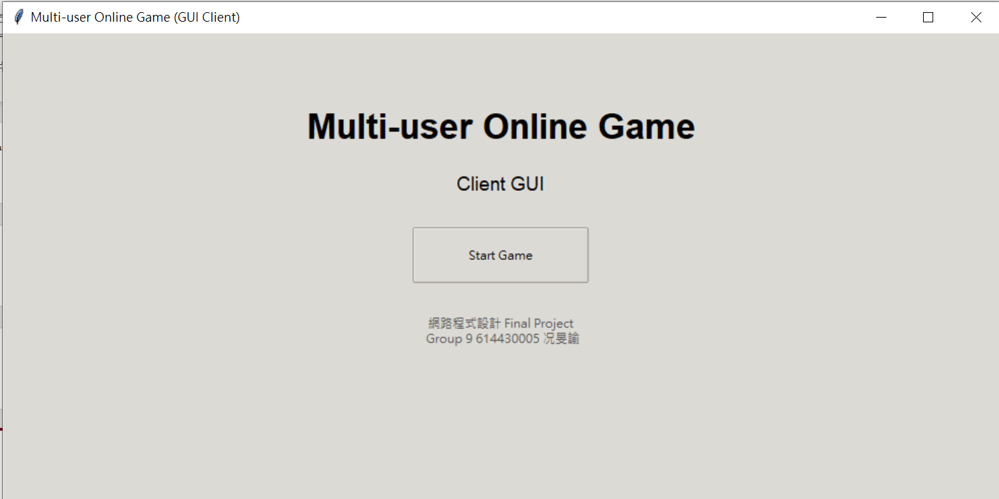
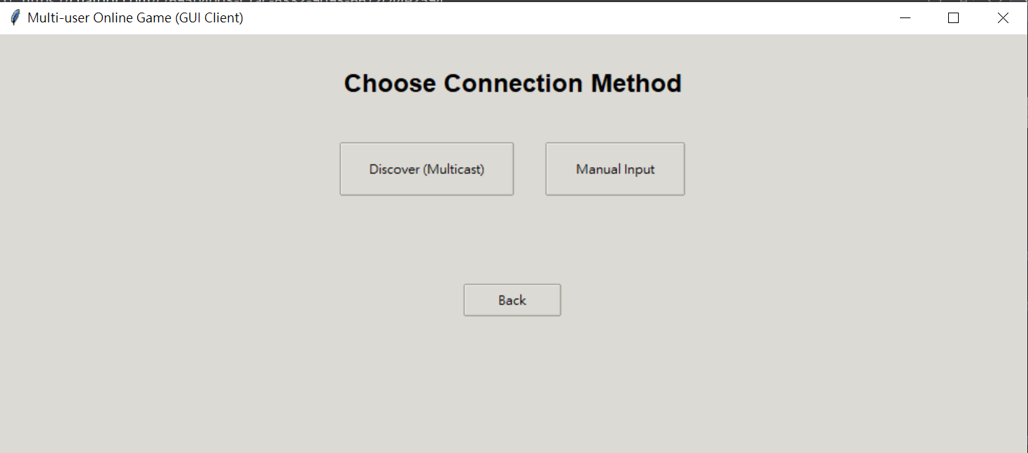
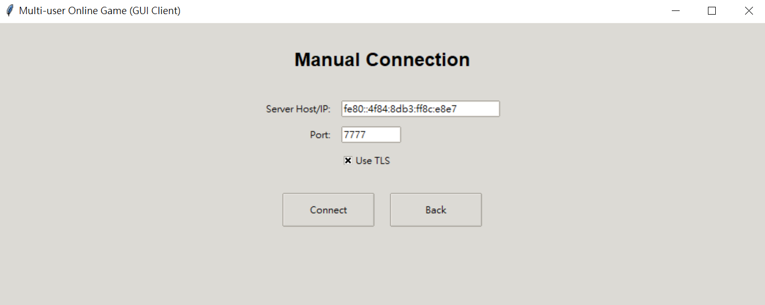
Screenshots of the execution

Slide 5
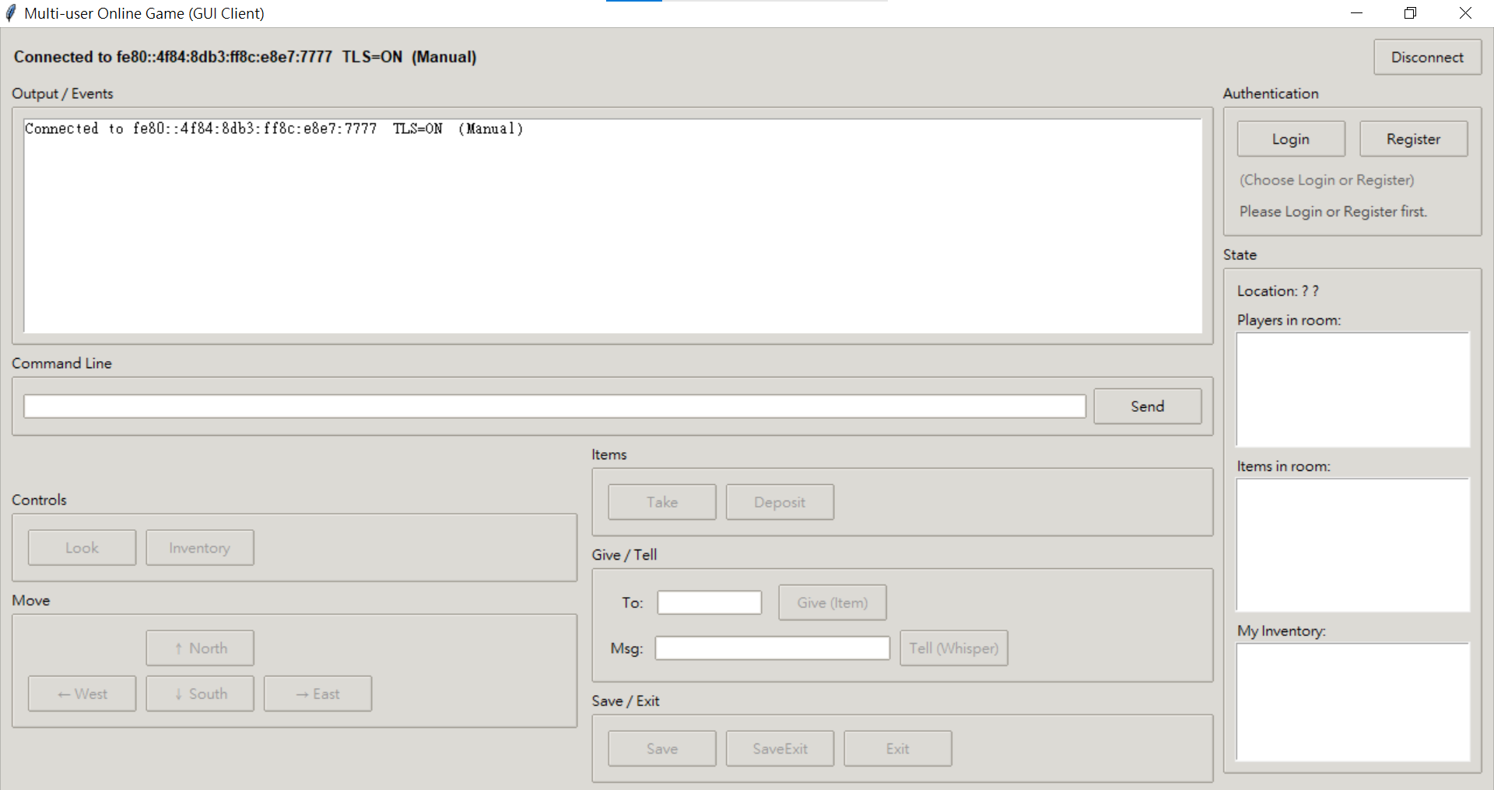
Screenshots of the execution

Slide 6
Screenshots of the execution

Slide 7
Screenshots of the execution

Slide 8
Screenshots of the execution

Slide 9
Screenshots of the execution

Slide 10
Demo

Slide 11
Q/A

